Slide 1
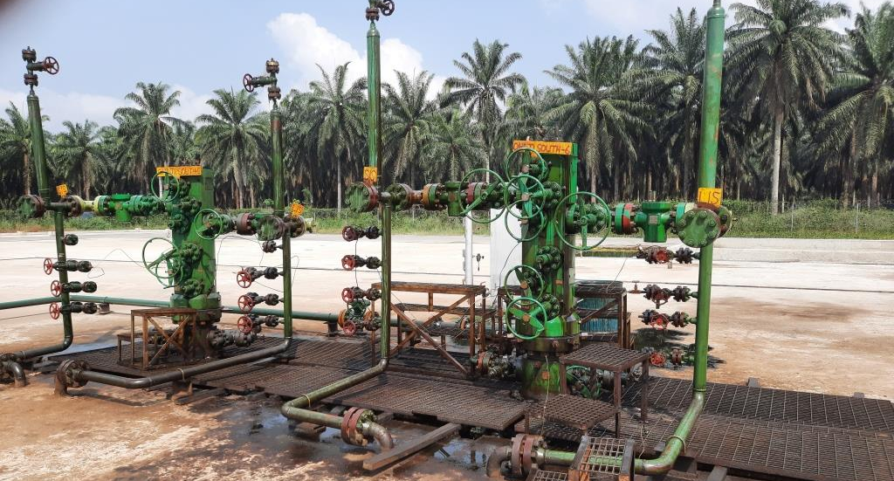
Ohaji South 5 and 6 Well Heads

Slide 2
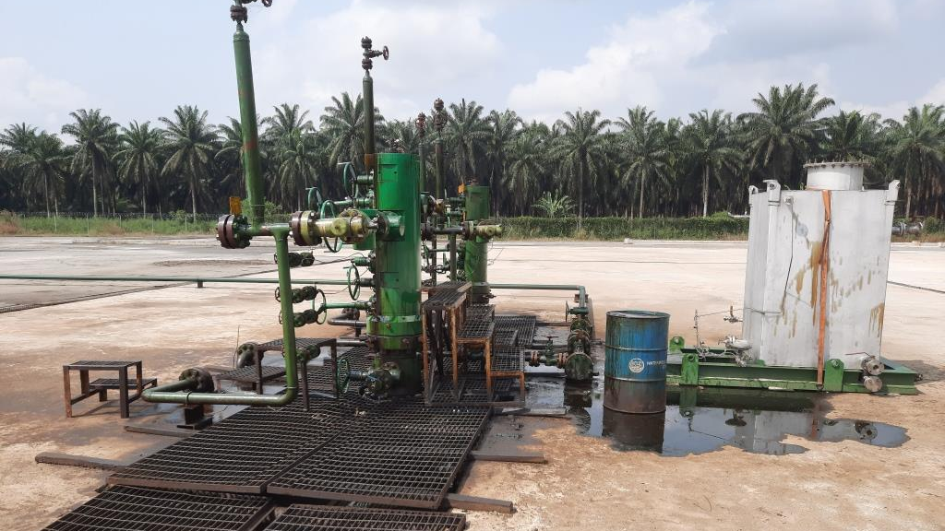
Oil Spill inside the Cellar Pit and outside on Concrete Surface

Slide 3
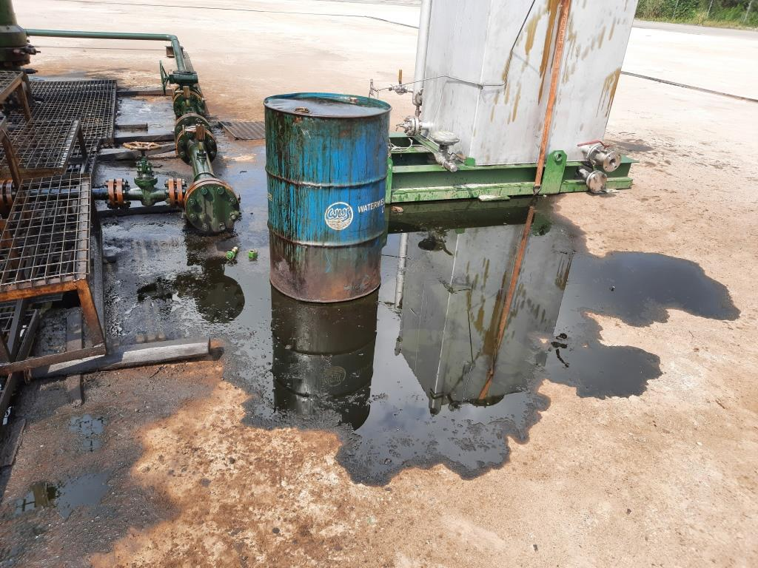
Oil Spill outside the Cellar Pit on Concrete Surface

Slide 4
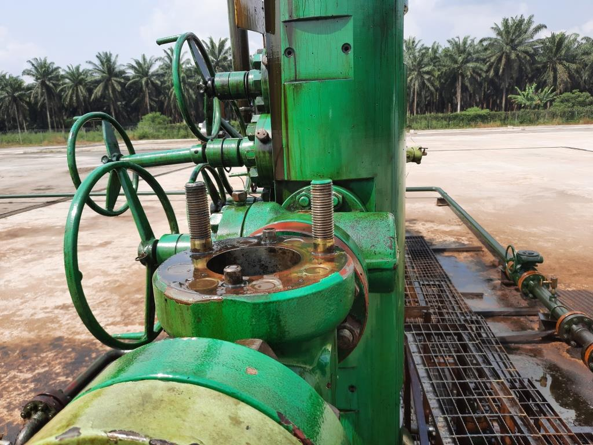
Position of Removed CCU Actuator

Slide 5
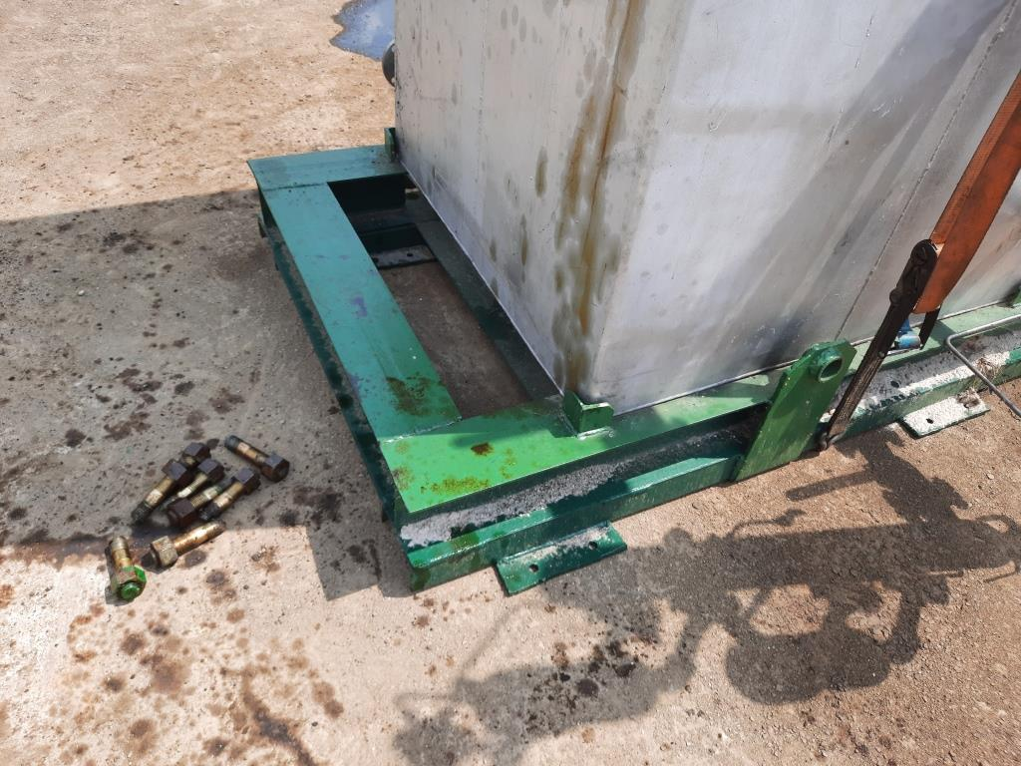

Slide 6
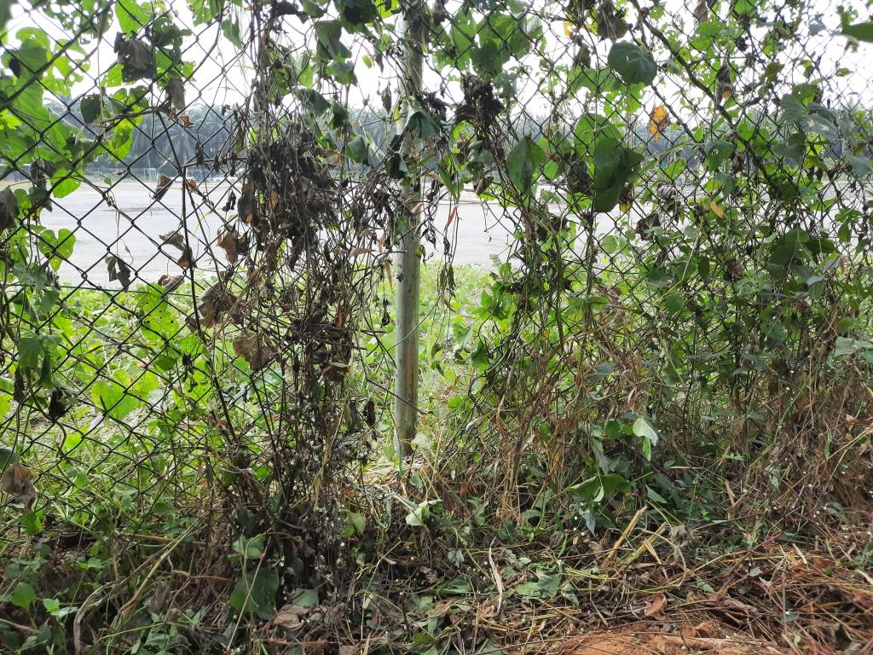
Illegal Access Cut through the Well Heads Location Fence by the unknown Persons

Slide 7
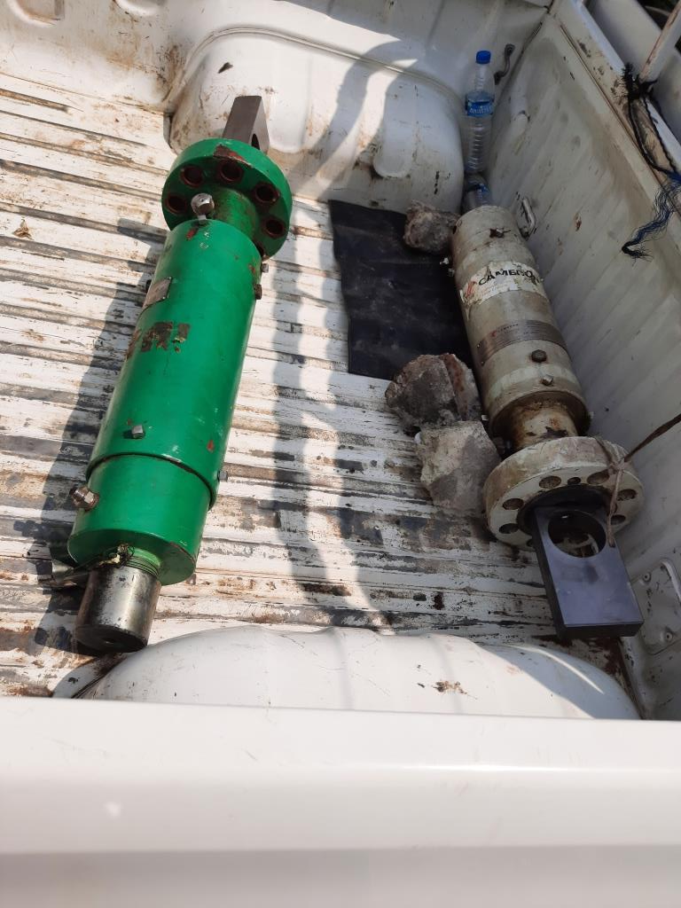
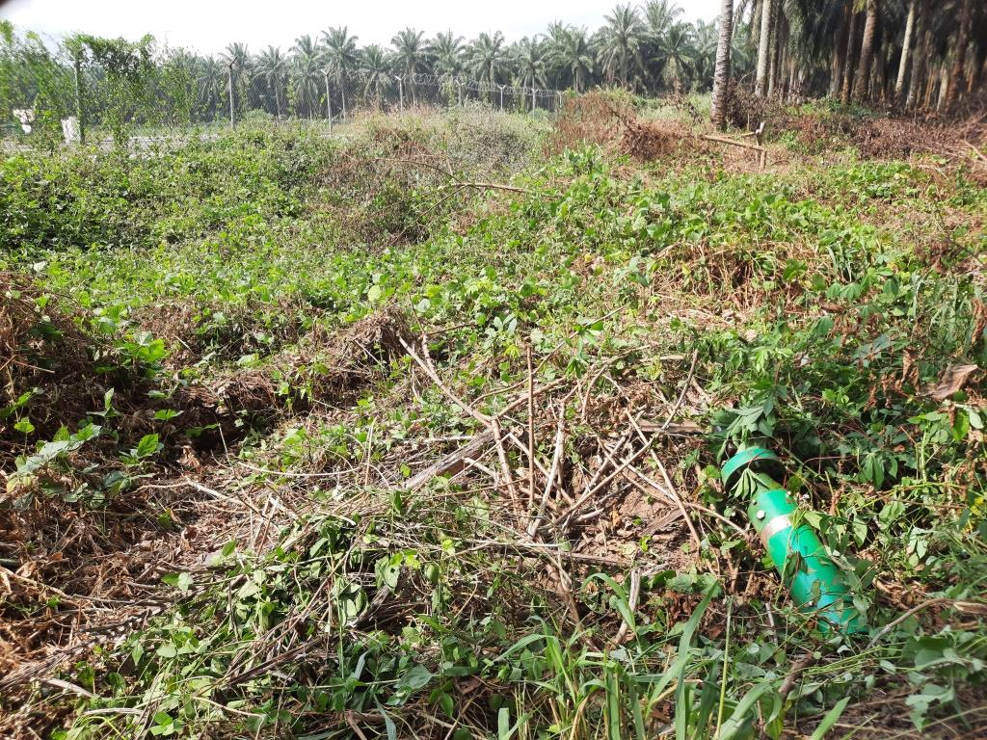
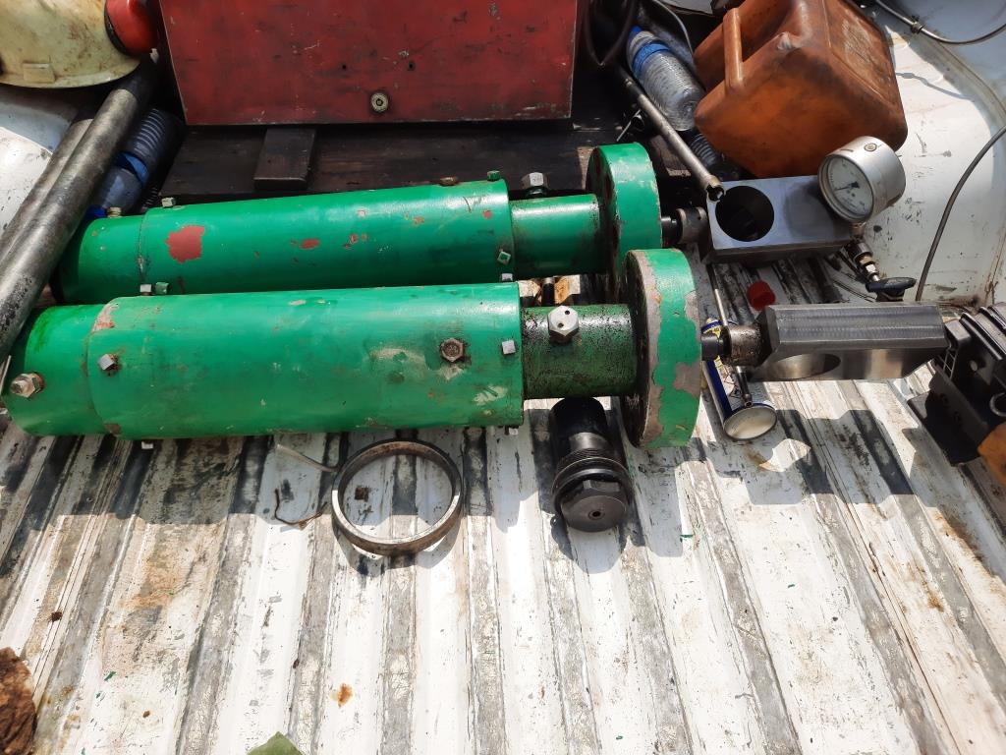
Recovered and Retrieved CCU Actuators

Slide 8
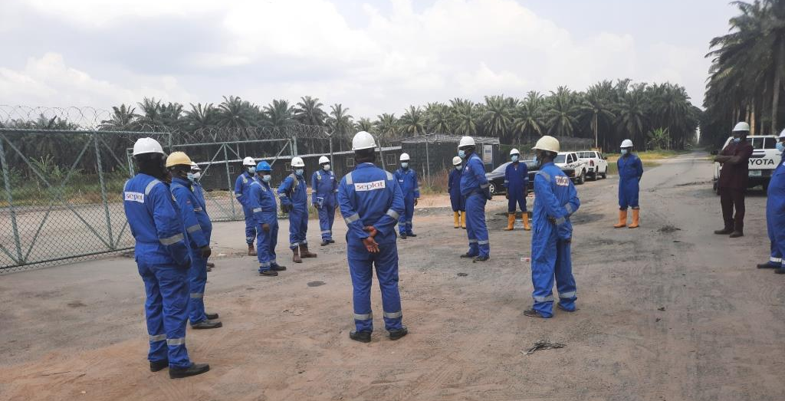
Onsite Briefing with the JIV Team

Slide 9
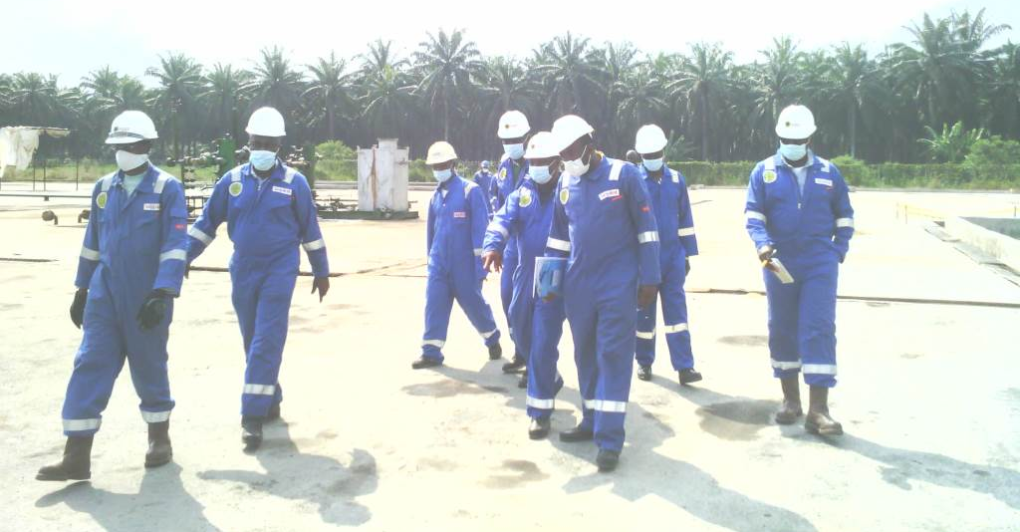
JIV Team Conducting Inspection at the Incident Location

Slide 10
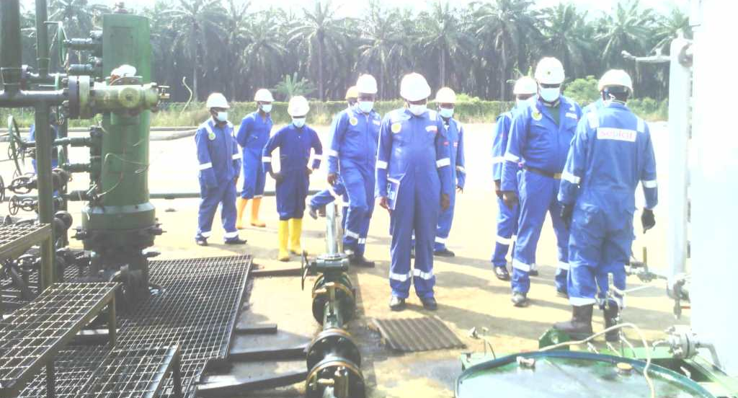
JIV Team Conducting Inspection at the Incident Location

Slide 11
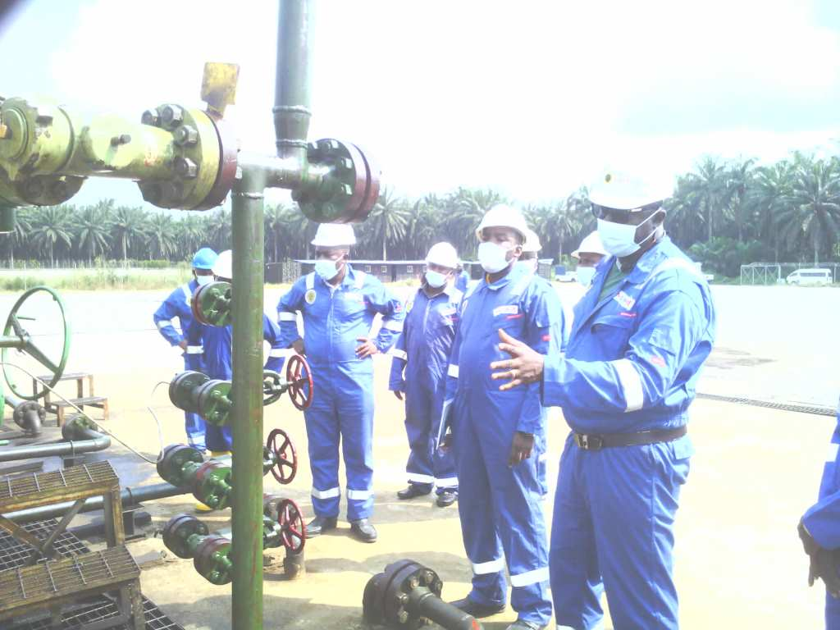
JIV Team Conducting Inspection at the Incident Location

Slide 12
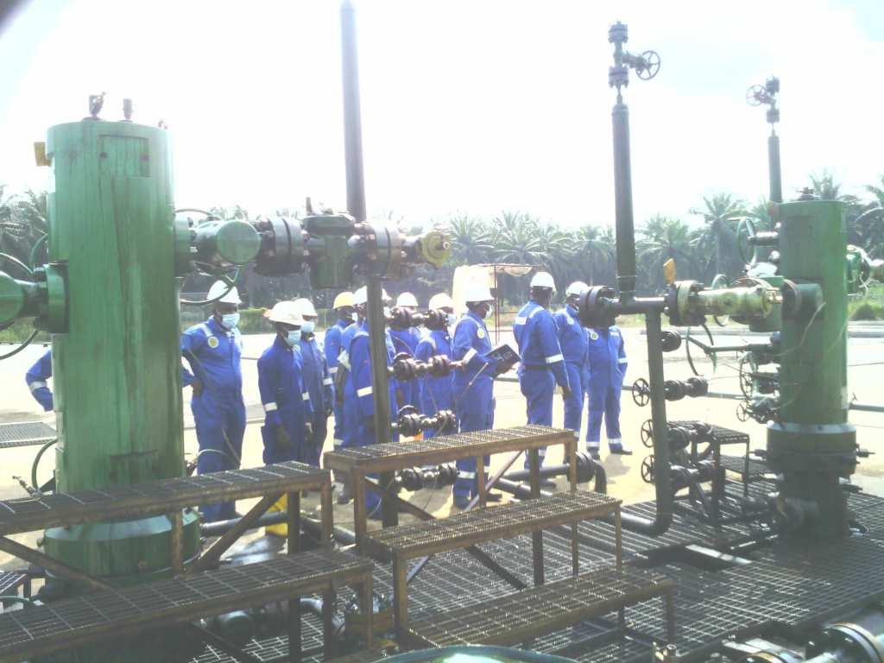
JIV Team Conducting Inspection at the Incident Location

Slide 13
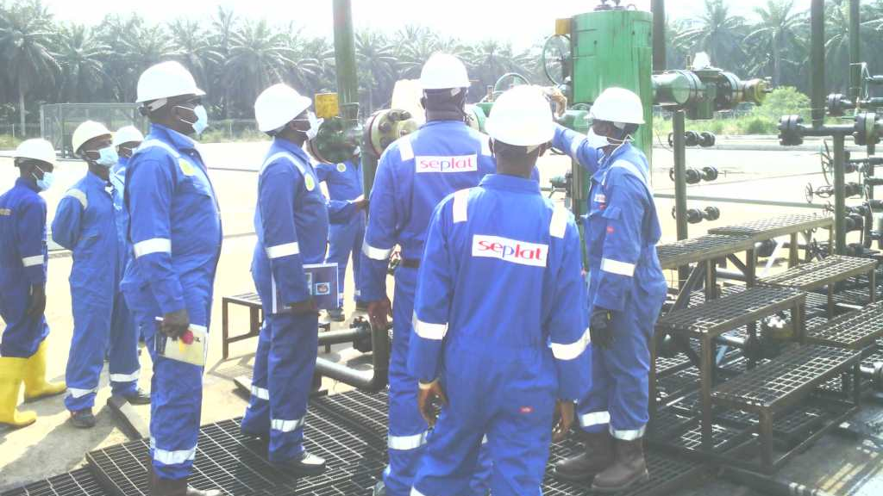
JIV Team Conducting Inspection at the Incident Location

